Slide 1
Coursera capstone IBM data science Where to open a restaurant in San Francisco depending on income of household

Slide 2
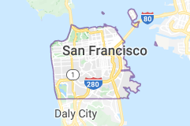
In city of san francisco

Slide 3
Introduction:
Location can also influence a business’s ability to market itself, the competition it faces from businesses, the total cost of operation, taxes the business owner has to pay and the regulations they must follow.
Location also matters for marketing. The importance of location goes beyond your business’ physical location and your website rank in Google search results. It extends to the placement of your advertisements.

Slide 4
Business problem
When deciding where to open a new location, there are a few business location advantages and disadvantages to consider. As previously noted, identifying a well-trafficked area can be critical to getting a business off the ground.
Consistent traffic is the key to driving daily revenues and can help generate the money necessary to pay back debts, such as business loans.

Slide 5
Audience
Location data can reveal a trove of information about a customer’s daily travel routines (such as commutes), recurring shopping habits (like grocery shopping or gas station stops), restaurant preferences, and even online-to-storefront purchasing behavior. The data allows for more personalized targeting for the products and services customers might care about and enables more efficient ad targeting and budget allocation for marketers.

Slide 6
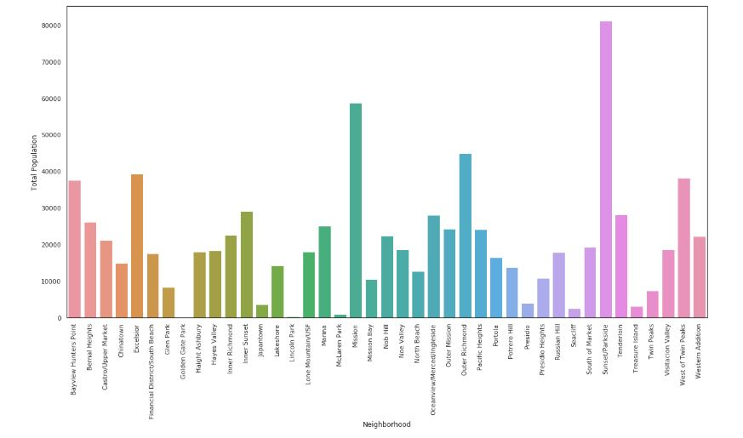
Results
box plot to see the distribution of population and whether there's any outliers.

Slide 7
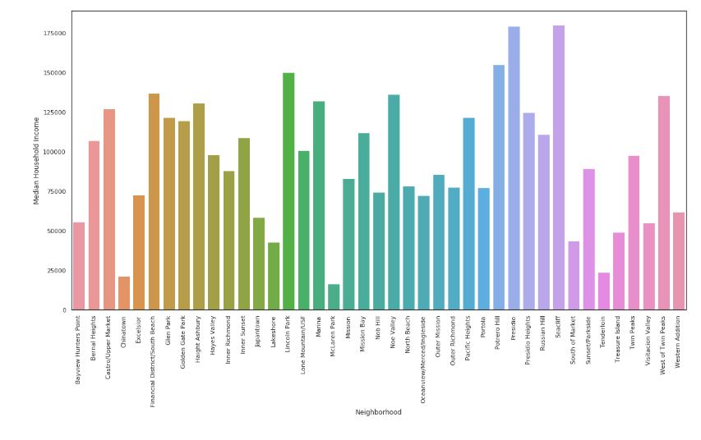
box plot to see the distribution of median household income and whether there's any outliers

Slide 8
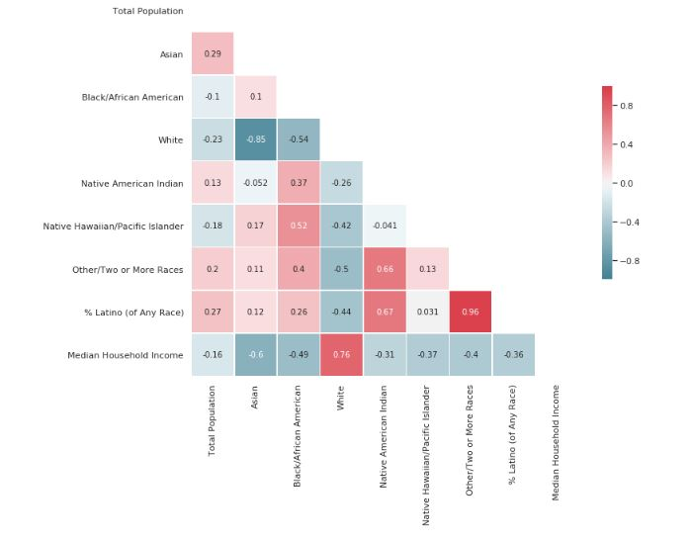

Slide 9
conclusion
We can see that higher percentage of White household corresponds with higher median household income, while the high percentage of any other race household corresponses negatively with median household income.

